Slide 1
Tic-Tac-Toe Game
Object-Oriented Programming through Java

Slide 2
Team Members
G. SANGEETHA – 2205A41L05
P. SRAVYA GEERVANI – 2205A41L15
B. SRIHITHA – 2205A41L26
J. SRIDEVI – 2205A41L35

Slide 3
CONTENTS
1. Introduction
2. Objectives
3. Elements Used in the Project
4. Design Aspects
5. Implementation Process
6. Screens
7. Results
8. Thank You

Slide 4
INTRODUCTION
This Tic-Tac-Toe project showcases the fusion of Java Swing for a dynamic user interface and AWS for potential cloud-based enhancements. Whether you're a beginner learning Java GUI programming or an enthusiast exploring cloud integration, this project provides an exciting platform to dive into both realms.
Project Overview:
1. Graphical User Interface with Java Swing:Our game features a user-friendly interface built using Java Swing, a robust framework for creating graphical user interfaces in Java.The game window includes a 3x3 grid, where players can make their moves by clicking on the cells.Instructions and messages are displayed using JTextArea, guiding players on how to start, make moves, and understand the game's outcome.
2. Cloud Integration with AWS:AWS, a leading cloud services platform, has been integrated to enhance the functionality of our Tic-Tac-Toe game.AWS services, such as Lambda functions or DynamoDB, could be utilized to enable features like online multiplayer, global leaderboards, or storing game statistics.

Slide 5
OBJECTIVES
The objective of the Tic Tac Toe game is for two players to take turns marking spaces in a 3x3 grid with their designated symbols (usually "X" for one player and "O" for the other). The goal is to be the first to achieve a specific pattern, typically three of their symbols in a row horizontally, vertically, or diagonally. The game ends when one player successfully forms the required pattern, and that player is declared the winner. If the entire grid is filled without a winner, the game is a draw. The simplicity of the rules makes Tic Tac Toe a widely played and understood game, often used as a pedagogical tool to teach basic game theory concepts.

Slide 6
ELEMENTS USED IN THE PROJECT
Grid/Board: The playing area where the game is conducted. In Tic Tac Toe, the grid is typically a 3x3 square.
Cell/Space: Each individual square within the grid where players can place their symbols ("X" or "O").
Symbol ("X" and "O"): The distinctive marks that players use to indicate their moves on the grid. One player usually uses "X," and the other uses "O.“
Turn: The sequence in which each player makes their move by placing their symbol on an empty space in the grid.
Move: The act of a player placing their symbol in an empty cell on the grid during their turn.
Winning Condition: The specific arrangement of three of the same symbols in a row (horizontally, vertically, or diagonally) that results in a player winning the game.
Three in a Row: The winning condition where three of the same symbols are aligned either horizontally, vertically, or diagonally.
Draw (Stalemate): The result is when the entire grid is filled, and no player has achieved three in a row. The game ends in a tie.
Player: The individuals participating in the game take turns to make moves.
First Move Advantage: The concept that the player who goes first has a slight strategic advantage in the game.
Fork: Creating a situation where a player has two ways to win on their next turn, forcing the opponent to choose which threat to block.
Block Opponent's Fork: Preventing the opponent from creating a situation where they have two potential winning moves on their next turn.

Slide 7
DESIGN ASPECTS
Designing the Tic-Tac-Toe game involves considering both the visual and structural aspects of the application. Here are design aspects to consider for a well-structured and visually appealing Tic-Tac-Toe game:
User Interface (UI) Design
Interactive Elements
Game Logic
Visual Styling:Consistent Theme
Scalability and Modularity
Testing
By carefully considering these design aspects, you can create a Tic-Tac-Toe game that is not only visually appealing but also robust and enjoyable for users. Keep the user experience in mind throughout the development process to create a seamless and engaging gaming experience.

Slide 8
IMPLEMENTATION PROCESS
Class Definition: The class TicTacToeGUI is declared, and the main functionality of the Tic-Tac-Toe game will be implemented within this class.
Instance Variables: These variables are used to manage the game state, including the GUI components (frame, buttons), the game board (board), the current player (currentPlayer), flags for game state (gameWon, gameStarted), and the number of moves (moves).
Constructor: The constructor initializes the GUI components, sets up the game board, and displays the main frame.
Frame Initialization: This code initializes the main frame with a title, size, default close operation, and layout.
Board Panel Initialization: A panel is created to hold the Tic-Tac-Toe board, and a 3x3 grid layout is set.
Button and Board Initialization: Arrays for buttons and the game board are created, and initial game state variables are set.
Initialize Board Method: This method creates and configures the buttons for the Tic-Tac-Toe grid, adding action listeners to handle player moves.
Start Game Method: The startGame method is called when the "Start Game" button is pressed, resetting the game state.
Display Result Method: This method is called when the game is won or drawn, displaying a message dialog with the result.
Main Method: The main method launches the application on the Event Dispatch Thread using SwingUtilities.invokeLater().
Check Win Method: The checkWin method checks whether the specified player has won the game by examining rows, columns, and diagonals.
Event Listeners: Action listeners are added to the "Start Game" and "Quit Game" buttons. Button action listeners handle player moves and check for a win or draw.
Text Area for Instructions: A text area is added to display instructions at the top of the frame.
Visibility of the Frame: Finally, the frame is set to be visible.

Slide 9
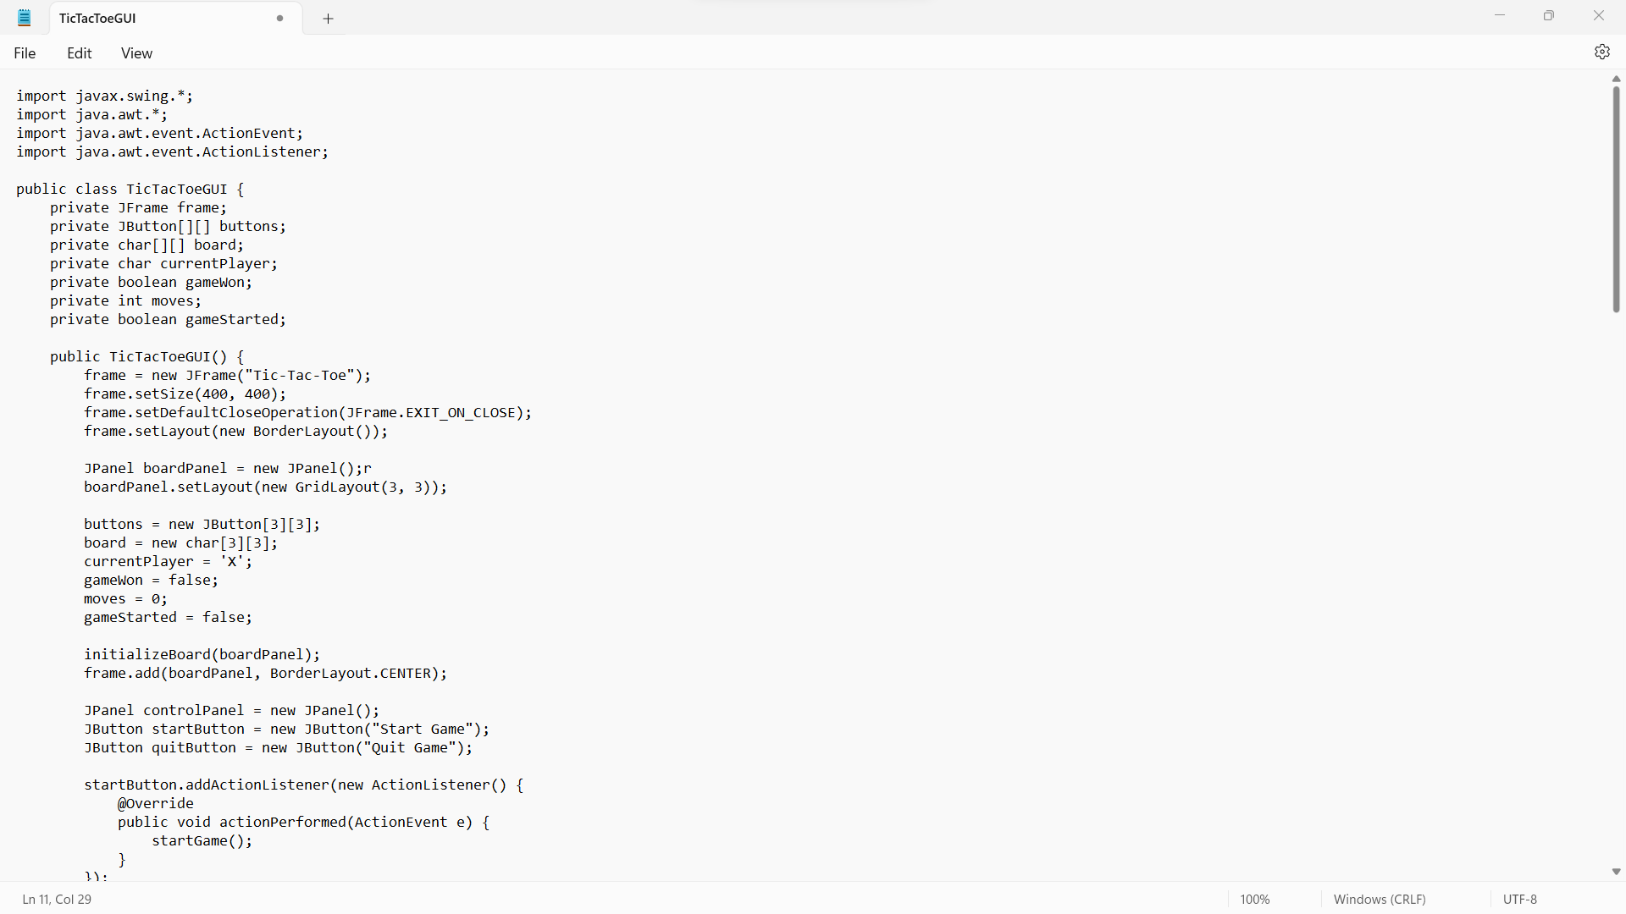
SCREENS

Slide 10
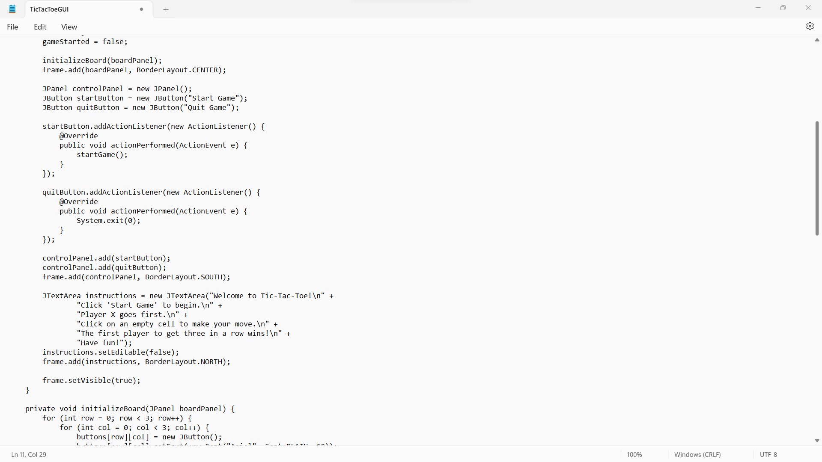
SCREENS

Slide 11
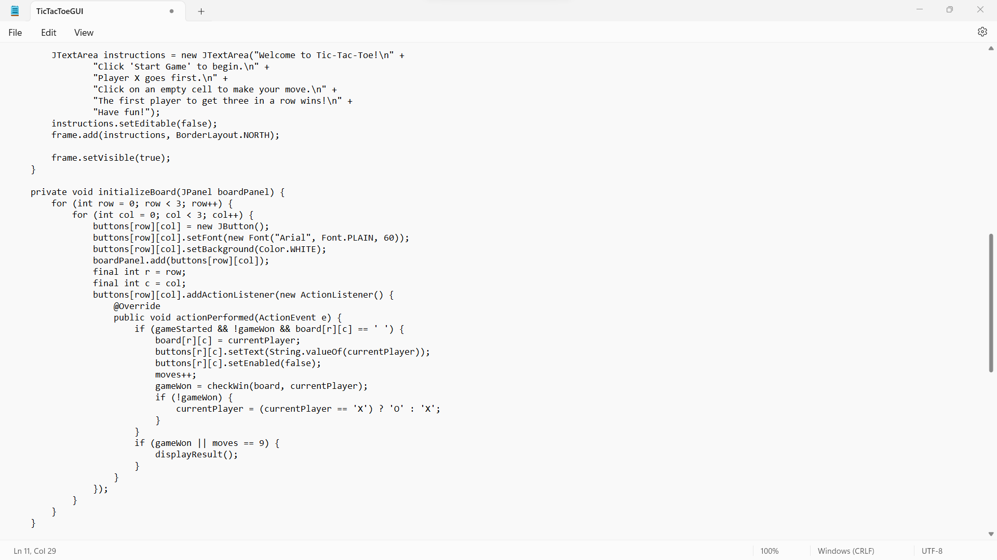
SCREENS

Slide 12
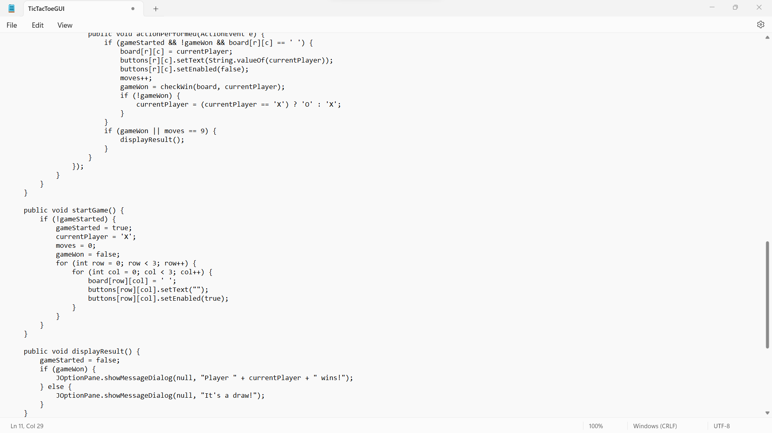
SCREENS AND FUNCTIONALITIES

Slide 13
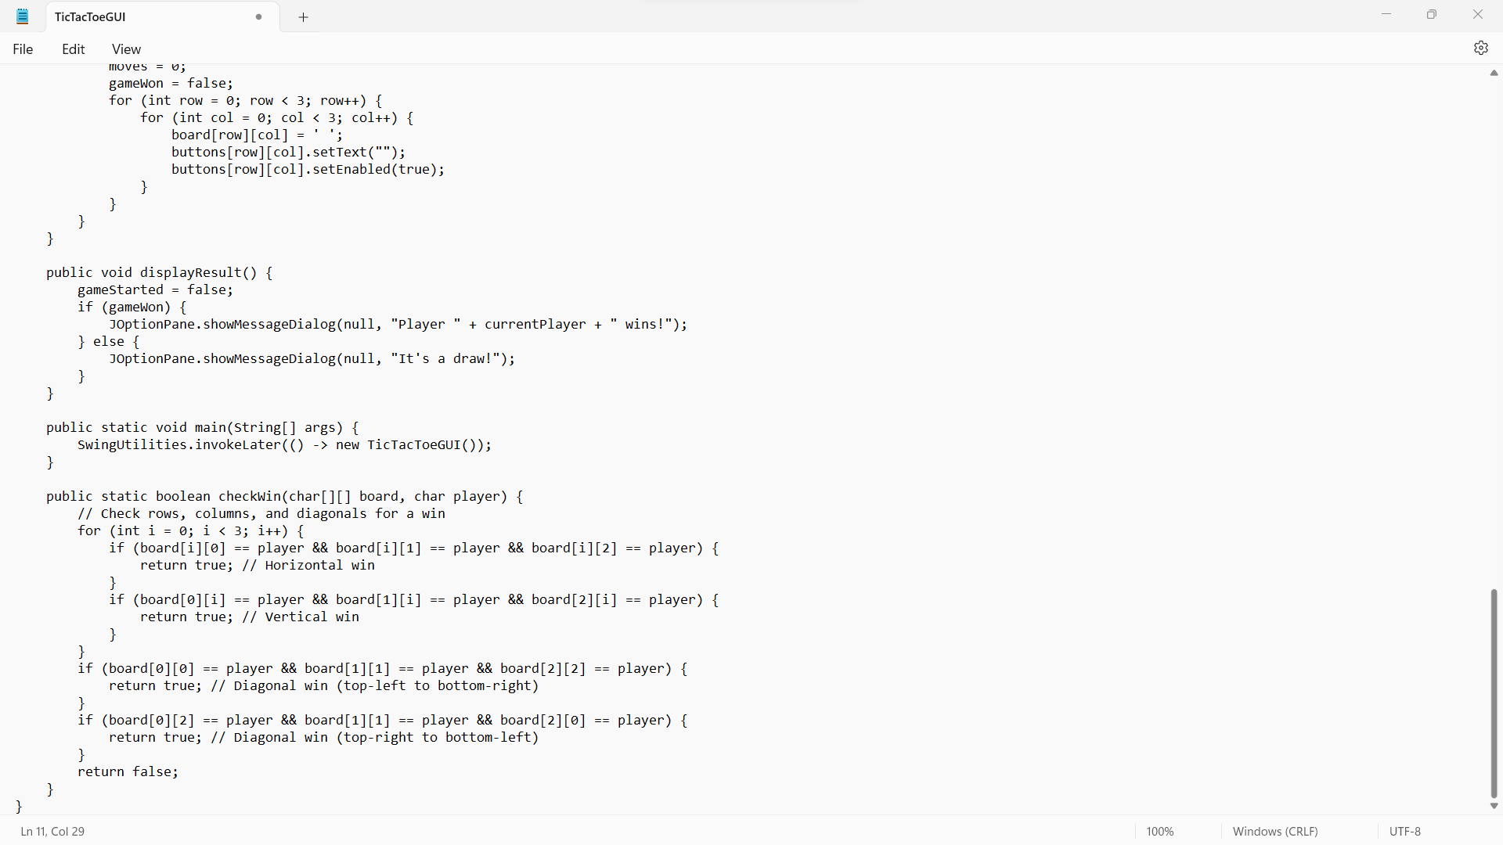
SCREENS

Slide 14
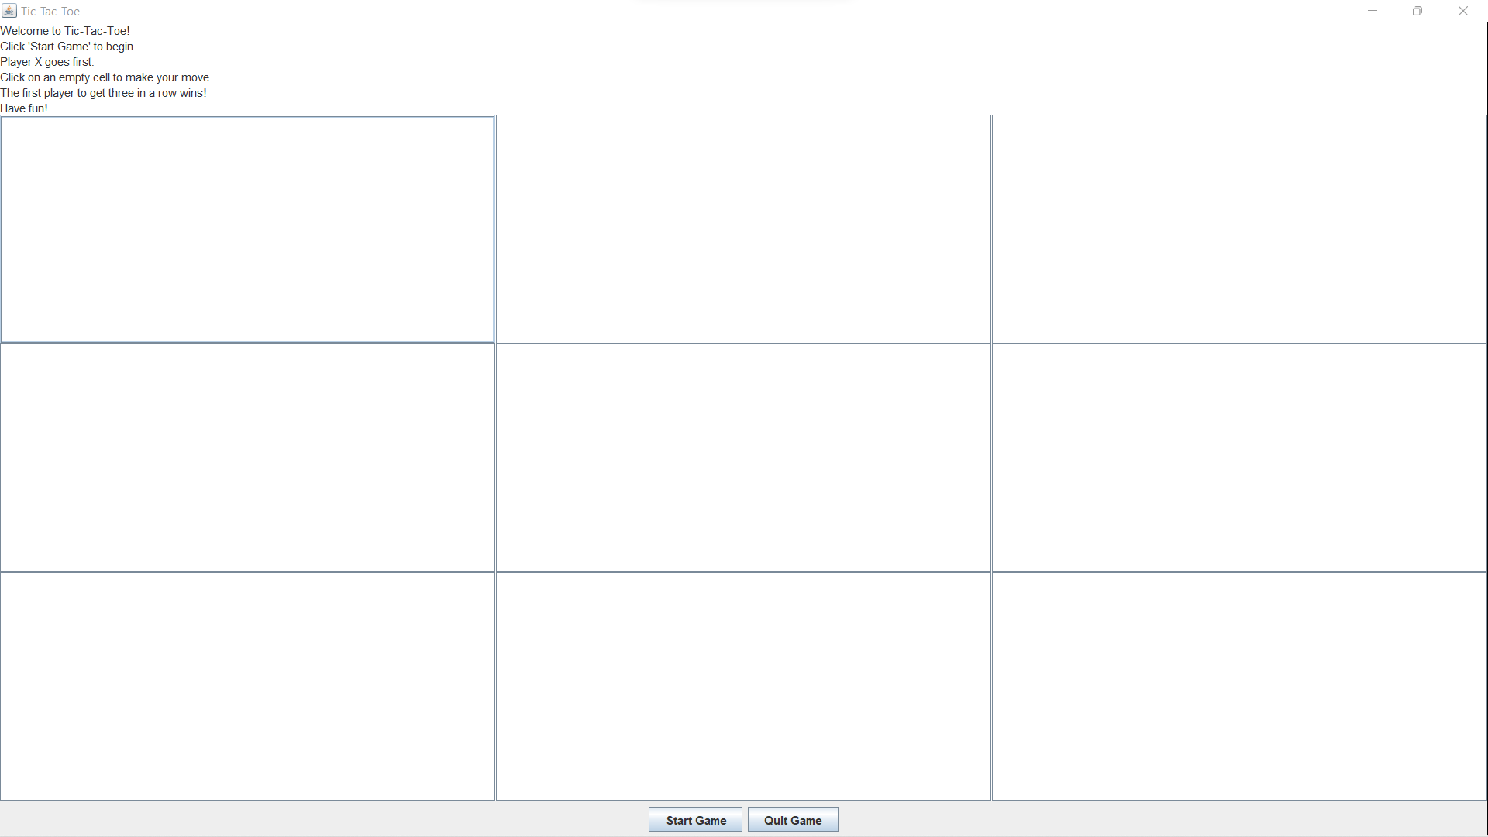
RESULT

Slide 15
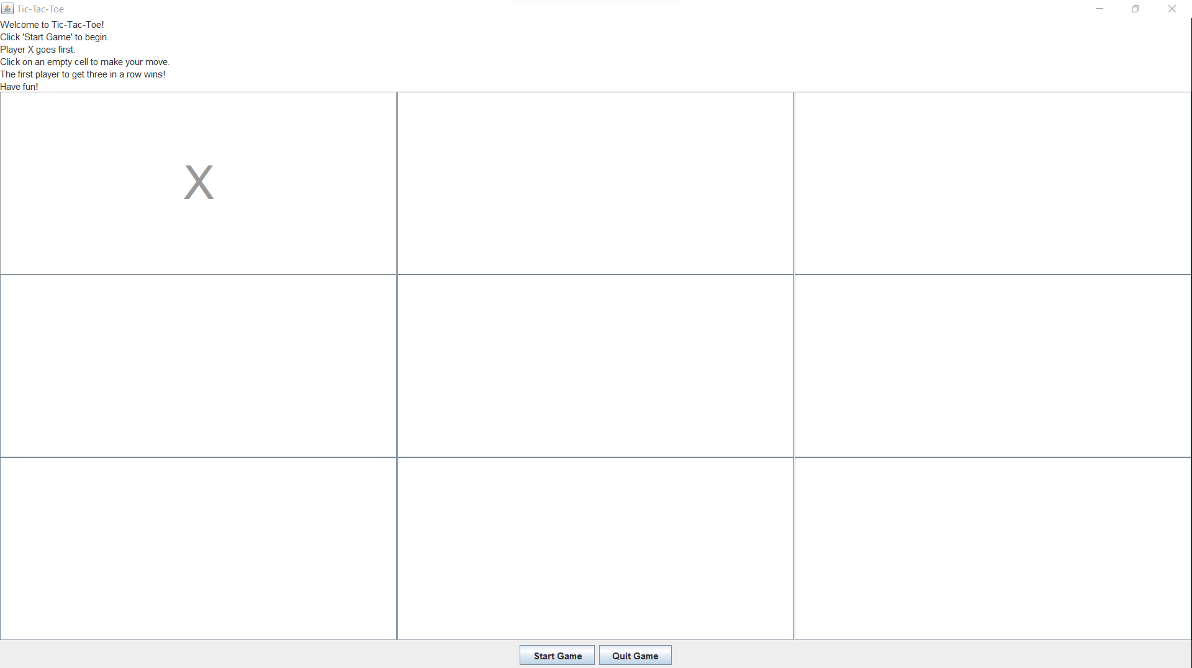
RESULT

Slide 16

RESULT

Slide 17
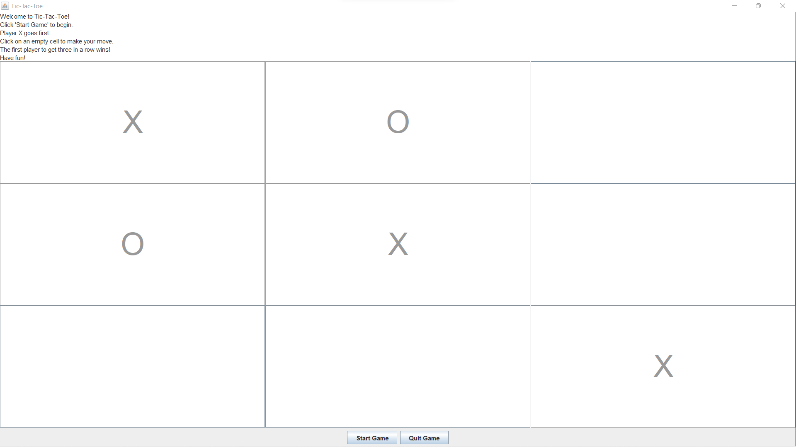
RESULT

Slide 18
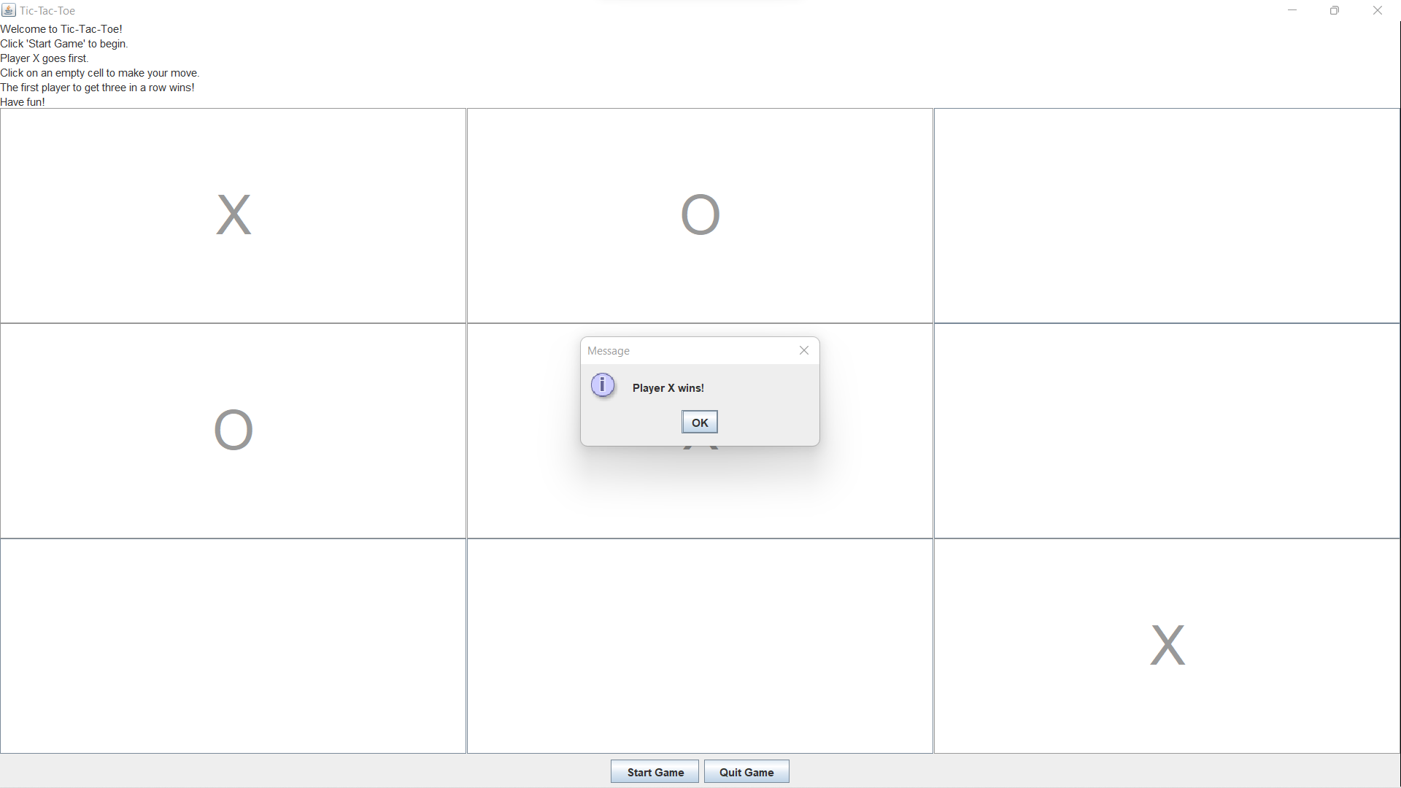
RESULT

Slide 19
CONCLUSION
The conclusion of a Tic Tac Toe game typically occurs when one player achieves a winning pattern or when all the cells on the game board are filled, resulting in a draw. A winning pattern can be a horizontal, vertical, or diagonal line of three matching symbols (X or O). If a player successfully creates such a line, they are declared the winner. On the other hand, if the board is filled without any player achieving a winning pattern, the game is declared a draw. In either case, the conclusion marks the end of the game, and players may choose to start a new game or conclude their gaming session.

Slide 20
THANK YOU
- We appreciate your time and attention.
- If you have any questions or feedback, please feel free to ask.
Thank you once again , for being a part of our presentation!

Slide 21
THANK YOU
- Contact Information:
Pogu Sravya Geervani
Mail : sravyapogu14@gmail.com
Mobile: 7013830487
Gabbeta Sangeetha
Mail: gabbetasangeetha@gmail.com
Mobile:8008406803

Slide 22
THANK YOU
- Contact Information:
Bommera Srihitha
Mail : srihithabommera@gmail.com
Mobile: 7893970756
Jatoth Sridevi
Mail: jatothsridevisridevi@gmail.com
Mobile: 9391098651

